Slide 1

KGiSL INSTITUTE OF TECHNOLOGY
COIMBATORE
DEPARTMENT OF computer science & engineering
MINI Project review # 03
COMPANION BOT USING FLUTTER FRAMEWORK
TEAM MEMBERS:
711720104086 SHARUN R
711720104094 SUJITHA K
711720104099 TAMILARASI P
711720104104 VIGNESWARAN S
Under the guidance of :
Mentor : Ms. Aarthi T

Slide 2

agenda
.
Objective of the project work
Existing System
Proposed System
Module Split-up
Expected Outcome
References
Timeline

Slide 3
abstract
Mental health is an important issue in the world today. With a large population now working from home and staying away from loved ones, the mental health situation has deteriorated. As such, it becomes important to track and remedy any problems before they get too serious. We try achieving this using the Companion Bot.
The project focuses on building a mental health tracker. You will try to get an idea of the mental state of your user, find out if they are suffering and then suggest measures they can take to get out of their present condition.

Slide 4
EXISTING SYSTEM
The autonomous device, which is also built to support the elderly, helps its owner interact with smart home environment as well as care givers. It is capable of speech and movement and can detect and track people at home.
DRAWBACKS OF EXISTING SYSTEM
Although robots can be superior to humans in some ways, they are less dextrous than humans, they don’t have such powerful brains, and cannot compete with a human’s ability to understand what they can see.

Slide 5
Literature survey
TITLE | PUBLICATION DETAILS | METHODOLOGY | MERITS | DEMERITS
ADAM- Anxiety Detection and Management: a Solution to Manage Anxiety at Workplaces and Improve Productivity | Dilara Mannapperuma Abarnah Kirupananada 2020 IEEE International Women in Engineering (WIE) Conference on Electrical and Computer Engineering | Rule-based machine learning model Anxiety Detection and Management | Easy to use and had appropriate navigation More accurate way of predicting anxiety than the manual scales More work specific activities can be created | Overall productivity is less

Slide 6
Literature survey
TITLE | PUBLICATION DETAILS | METHODOLOGY | MERITS | DEMERITS
Accompany: Acceptable robotics Companions for Ageing Years Multidimensional Aspects of Human-System Interactions | Farshid Amirabdollahian 2013 6th International Conference on Human System Interactions (HSI) | human-robot interaction, robot learning and memory visualisation, monitoring persons | context of a smart-home environment utilising a multitude of sensor arrays | Evaluation activities with less accuracy Ethical framework

Slide 7
Literature survey
TITLE | PUBLICATION DETAILS | METHODOLOGY | MERITS | DEMERITS
Model of Multi-turn Dialogue in Emotional Companion bot. | Chien-Hao Kao, Chih-Chieh Chen, Yu-Tza Tsai Published on 1 November 2019 | Text sentiment recognition enables a chatbot to know the user’s emotional state and select the best response, which is important in medical care. | It can exhibit different emotional reactions based on the content of the user’s conversation. | Difficult to solve the legal and social issues.

Slide 8
PROPOSED SYSTEM
As a concept, Older people and roboticists interacted with eight companion robots or alternatives at two separate events in groups of two to four people. Interactions were recorded, participants’ comments and observations were transcribed, and content was analysed
ADVANTAGES OF PROPOSED SYSTEM
Companion robots may reduce agitation and depression for older people with dementia.
In current world it helps to comeout from over mental pressure

Slide 9
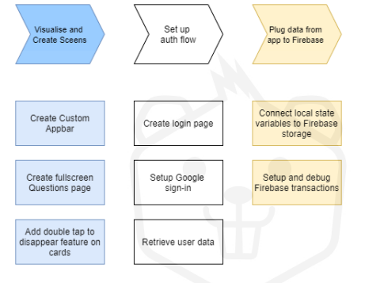
Architectural Diagram

Slide 10
Modules split up
Module 1: Building a screen
Module 2: Questions screen using UI refinement
Module 3: Setting up firebase
Module 4: Adding Google sign in feature

Slide 11
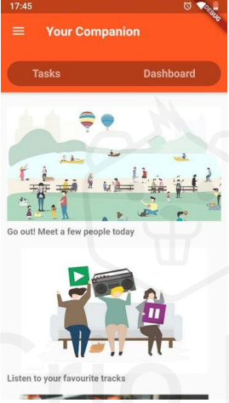
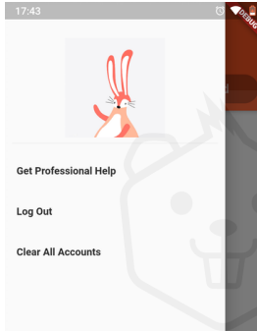
module 1-building a screen

Slide 12
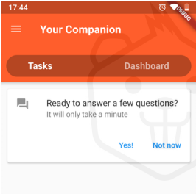
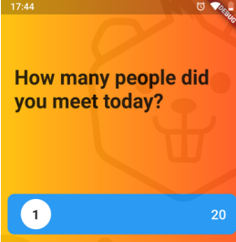
Module 2- questions screen using ui refinement

Slide 13
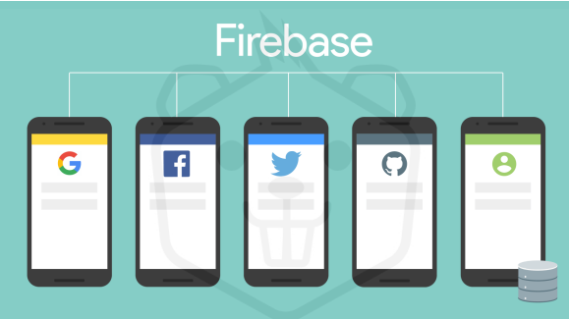
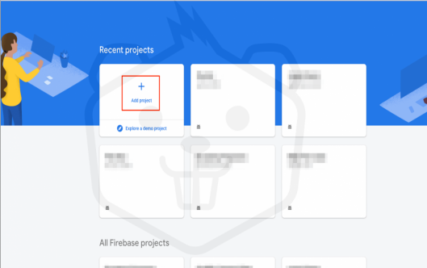
module 3 – Setting up firebase

Slide 14
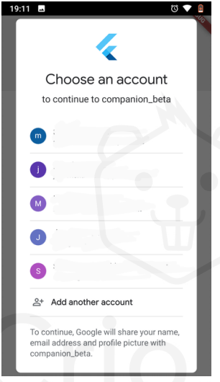
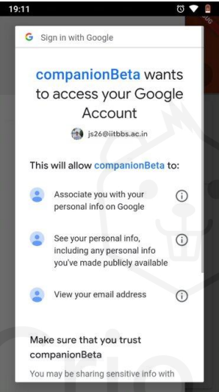
module 4 - Adding Google sign in feature

Slide 15
Conclusion & future enhancement
We have provided empirical support for the necessity and designed in the development of companion bots targeted for mentally affected people. Our results demonstrate stark differences in preferences and requirement between mentally affected people and bots, suggesting that engaging the end user in the design and development of companion robots is essential.
Further desirable functions were also identified that are not currently included as standard on companion robots, such as eye-contact, life-simulation features, personalisation, obeying commands and the potential for interactive language.

Slide 16
REFERENCE
Xiong, Caihua; Huang, Yongan; Xiong, Youlun (2008). Intelligent Robotics and Applications: First International Conference, ICIRA 2008 Wuhan, China, October 15-17, 2008
Sojka, Petr; Horak, Aleš; Kopecek, Ivan (2008). Text, Speech and Dialogue: 11th International Conference
Wang, Kelly. "'iPal' robot companion for China's lonely children". phys.org. Retrieved 10 December 2021.
Lamers, Maarten H.; Verbeek, Fons J. (2011). Human-Robot Personal Relationships: Third International Conference, HRPR 2010, Leiden.
"NICOBO, a robot born out of empathy with consumers and sense of mission". Panasonic. Panasonic. Retrieved 2 May 2023

Slide 17
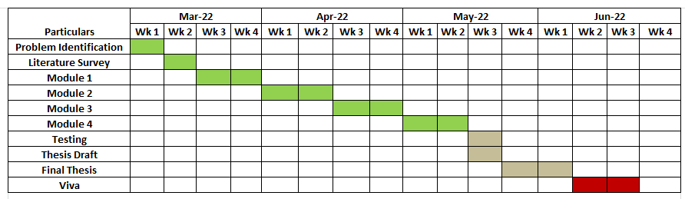
TIMELINE

Slide 18
THANK YOU

